Slide 1
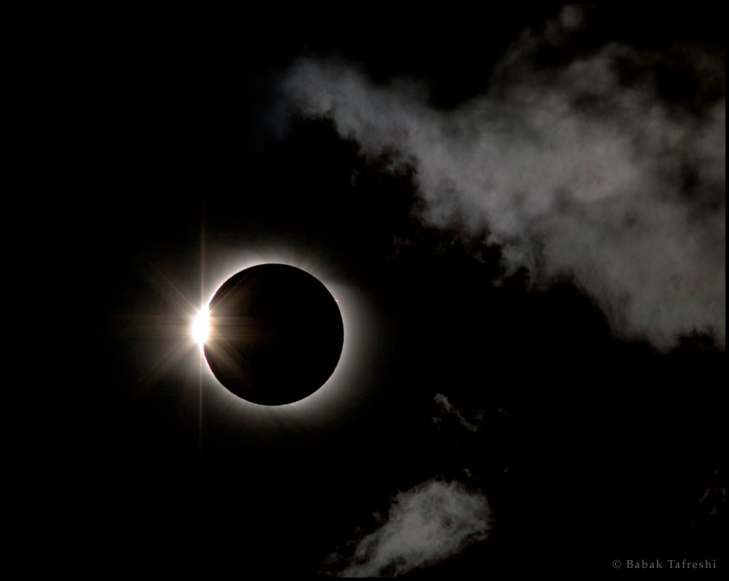

OBSCURATION TOTALITY
Brandon Wilson

Slide 2
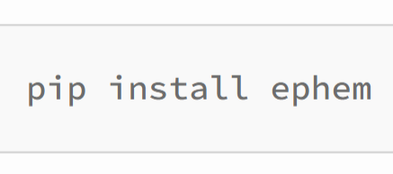
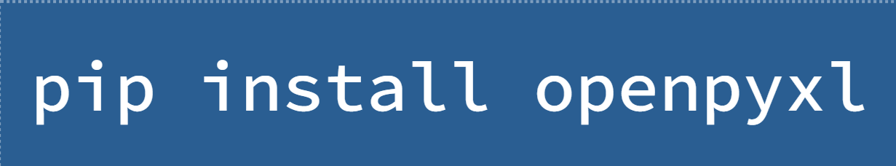
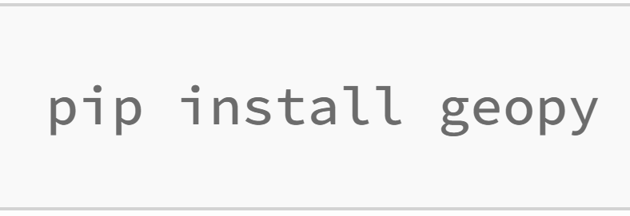
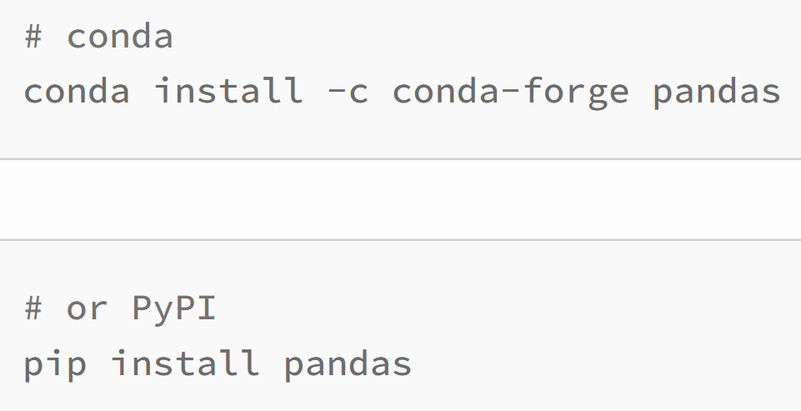
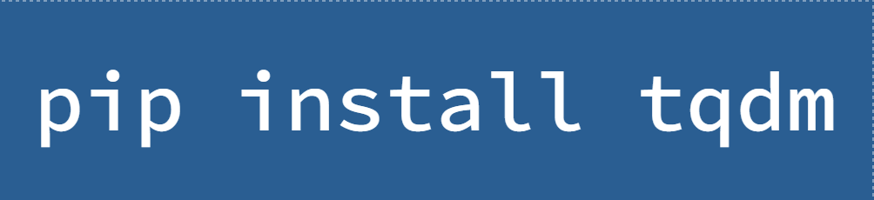
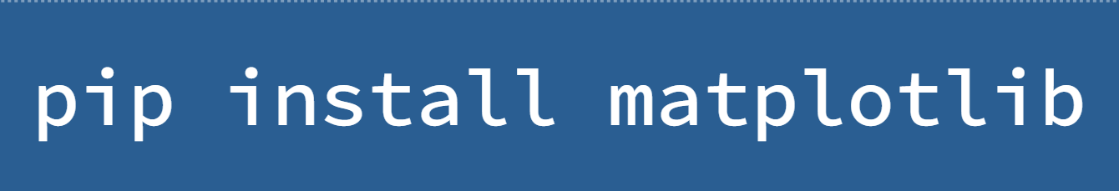
ALL PYTHON PACKAGES UTILIZED:
Ephem - PyEphem provides ephem Python package for performing high-precision astronomy computations
Openpyxl - Python library to read/write Excel xlsx/xlsm/xltx/xltm files
Geopy - Python client for several popular geocoding web services
Pandas - Python package that provides fast, flexible, and expressive data structures designed to make working with “relational” or “labeled” data both east and intuitive
tqdm - Python package that instantly makes loops show a smart progress meter
matplotlib - Python comprehensive library for creating static, animates, and interactive visualizations in Python
Math - Built-in Python library made to simplify mathematical tasks in Python
Datetime - Built-in Python package that contains capacities and classes for working with dates, times, and timezones

Slide 3
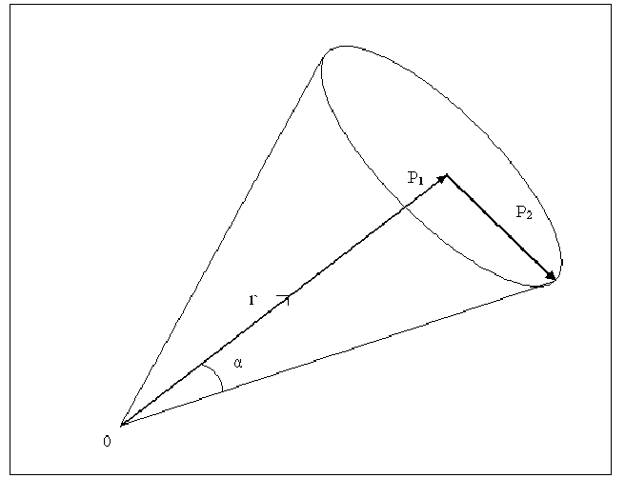
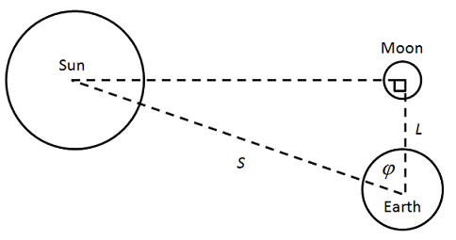
CALCULATING OBSCURATION…
Obscuration - the fraction of the Sun’s surface area covered by the Moon
Obscuration Simulation
Calculate the Angular Radii
Distance between Sun and the Moon
If the Distance ≥ the Sum of the Sun and Moon’s angular radii, NO obscuration.
If the Distance ≤ the absolute difference of their radii, obscuration OCCURS.

Slide 4
FILE ACCESS & EXPLANATION:
Obscuration Totality - Access

Slide 5
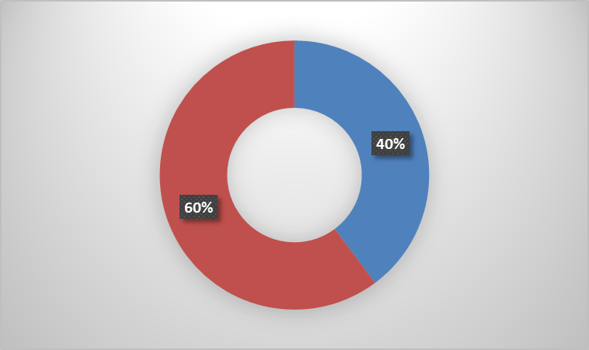
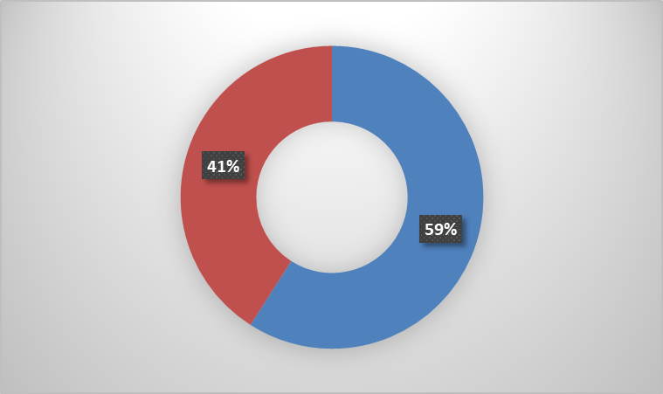
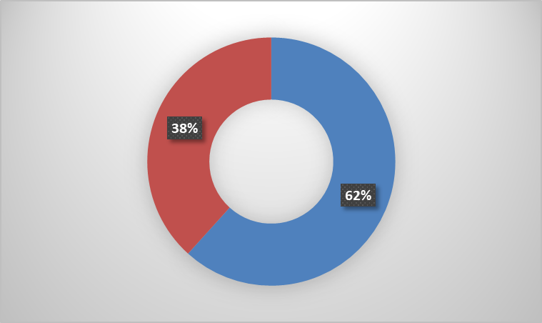
DATA ANALYSIS:
OBSCURATION PIE CHART
4:00:00 hrs
8:00:00 hrs
12:00:00 hrs
69.0%
78.7%
88.5%
࣑ - ≤ average obscuration %
࣑ - ≥ average obscuration %

